Slide 1
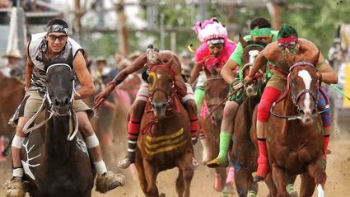
Indian Relay Races

Slide 3
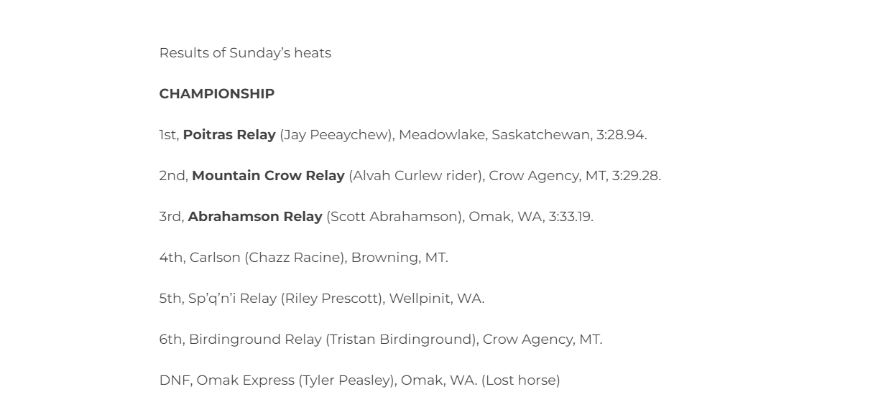
INDIAN RELAY RACES @ Emerald Downs
Auburn, WA
JUNE 14-16, 2024
First Prize was worth $11,200!

Slide 4
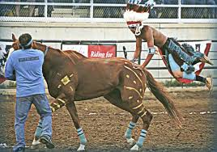
Group Discussion
Have you ever watched the sport of Indian relay before?
How important do you think it is to keep traditions like this alive as connections to the past?

Slide 5
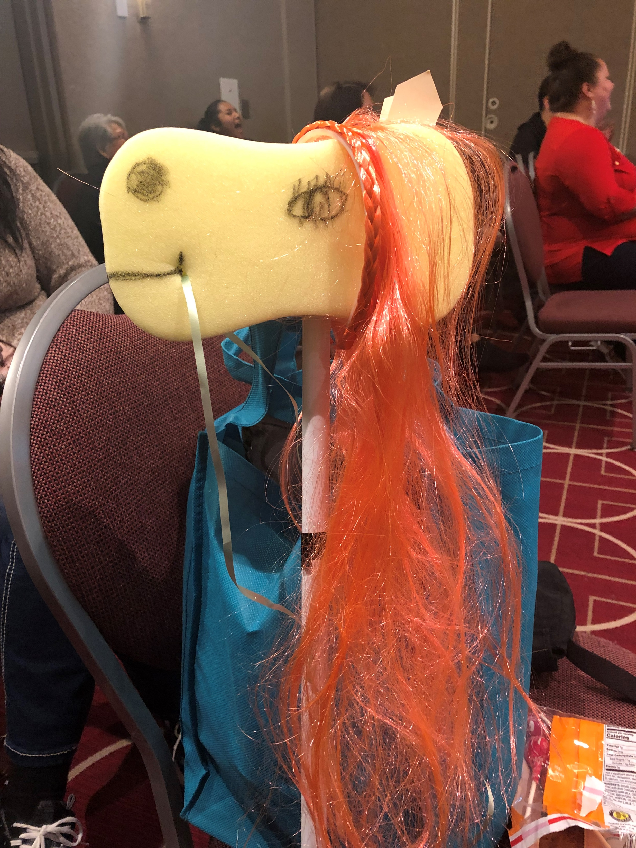
NAYLA Indian Relay Race
Get into teams of 8 – 10 people
Name your team
As a team, create your horse
Name your horse
Pick three riders
Each rider will race horse around gym once and then hand horse off to next rider
Awards for teams with fastest horse and best looking horse

Slide 6
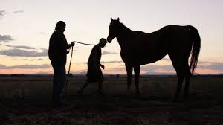
One of the coolest things about the sport of Indian Relay is that the horses these teams use are "retired" flat-track races horses, given a 2nd chance at life. These horses are often 4- or 5-year olds, past their prime (think of the Kentucky Derby, which is a race for 3-year olds). Relayers buy them for reduced prices and give them a lot of love for years--because the best Relay horses are the older, wiser ones. Relay horses, no longer racing, are honored for their past victories, live out their remaining days in the pastures around the family home.
Charles Dye, filmmaker

Slide 7
The story of the relationship of Native peoples and horses is one of the great sagas of human contact with the animal world. Native peoples have traditionally regarded the animals in our lives as fellow creatures with which a common destiny is shared. When American Indians encountered horses—which some tribes call the Horse Nation—they found an ally, inspiring and useful in times of peace, and intrepid in times of war. Horses transformed Native life and became a central part of many tribal cultures.
By the 1800s, American Indian horsemanship was legendary, and the survival of many Native peoples, especially on the Great Plains, depended on horses. Native peoples paid homage to horses by incorporating them into their cultural and spiritual lives, and by creating art that honored the bravery and grace of the horse.
The glory days of the horse culture were brilliant but brief, lasting just over a century. The bond between American Indians and the Horse Nation, however, has remained strong through the generations.
https://americanindian.si.edu/exhibitions/horsenation/index.html

Slide 8
https://youtu.be/8FNYWcPpN6c

